Slide 1





Smart Care:
Advanced Monitoring and Predictive Analytics for Elderly Care
Final Year Project

Slide 2

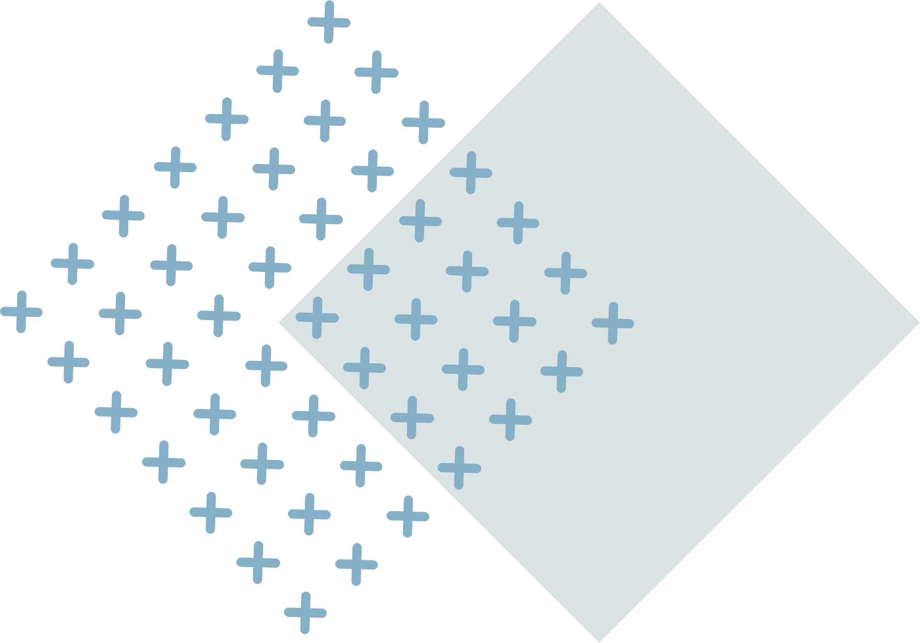
Group Members
LAIBA RAFIQ
FA21-BCS-051
KHUNSHA TAHIR
FA21-BCS-099
ZAHRA BAIG
FA21-BCS-063
Supervisor
Sir IMRAN RAZA

Slide 3

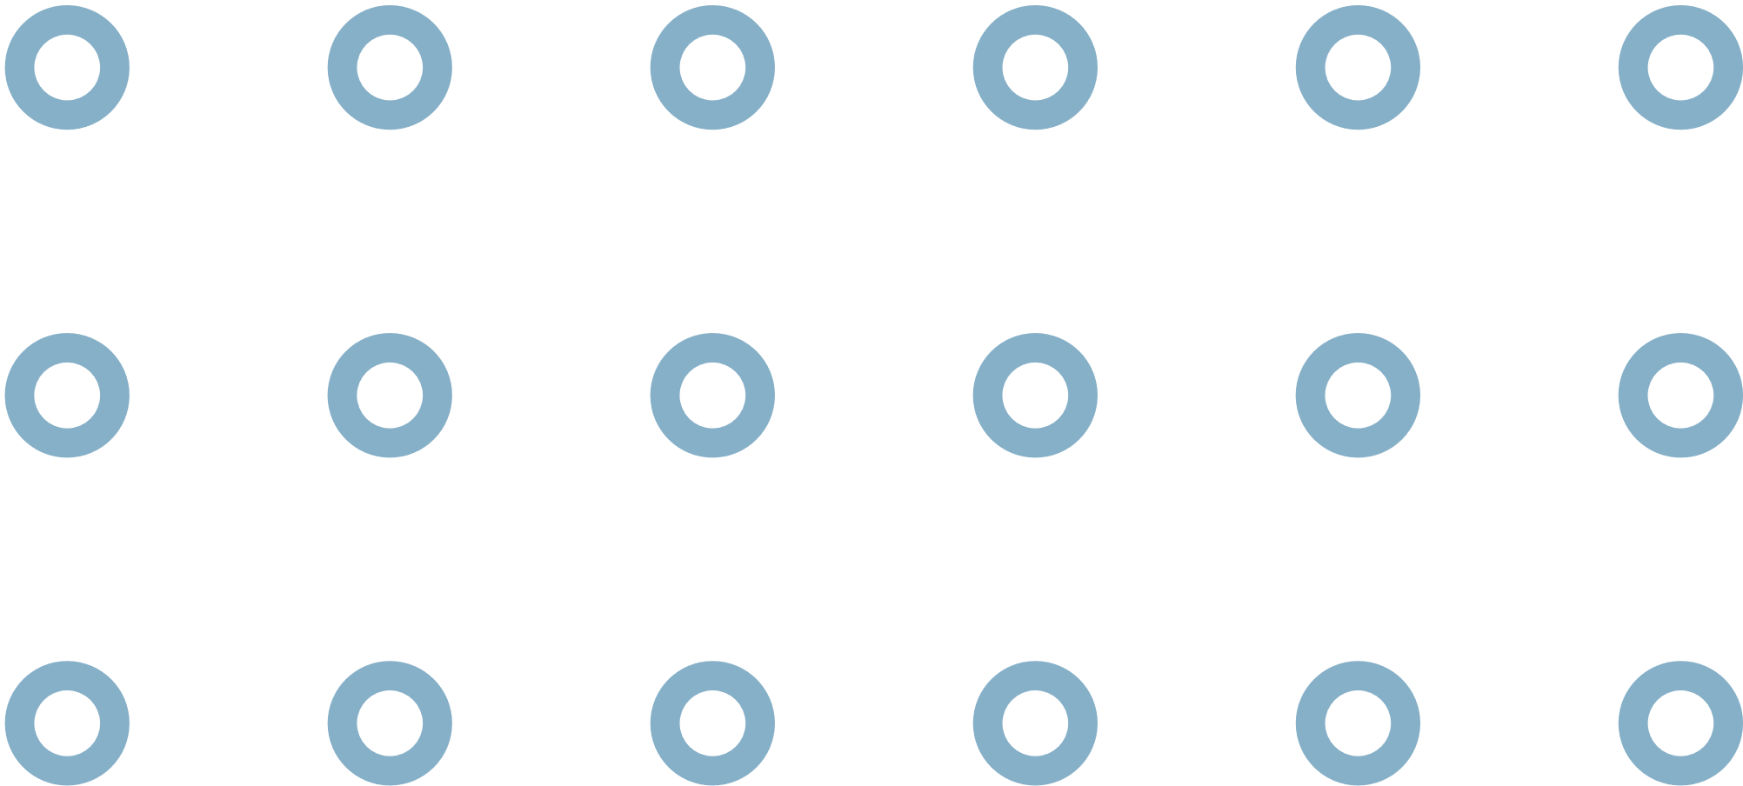
Outline
01 INTRODUCTION
02 LITRATURE REVIEW
03 PROBLEM STATEMENT
04 PROPOSED DESIGN
05 INTERFACE
06 CONCLUSION

Slide 4
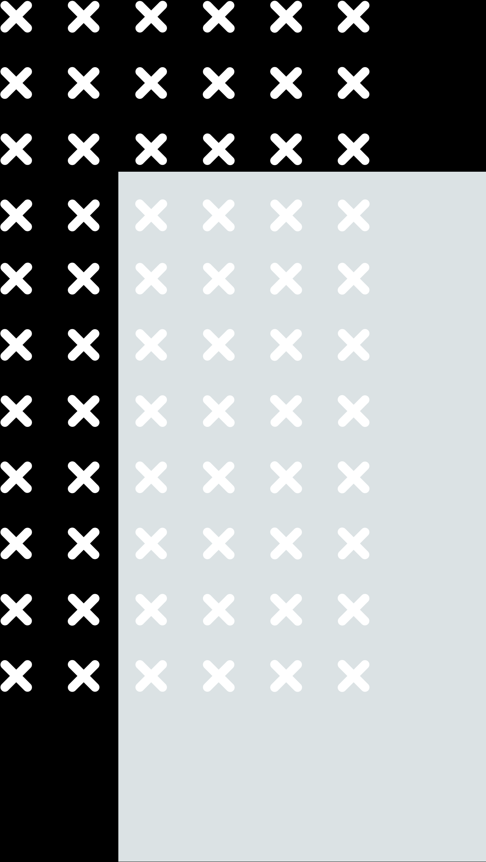
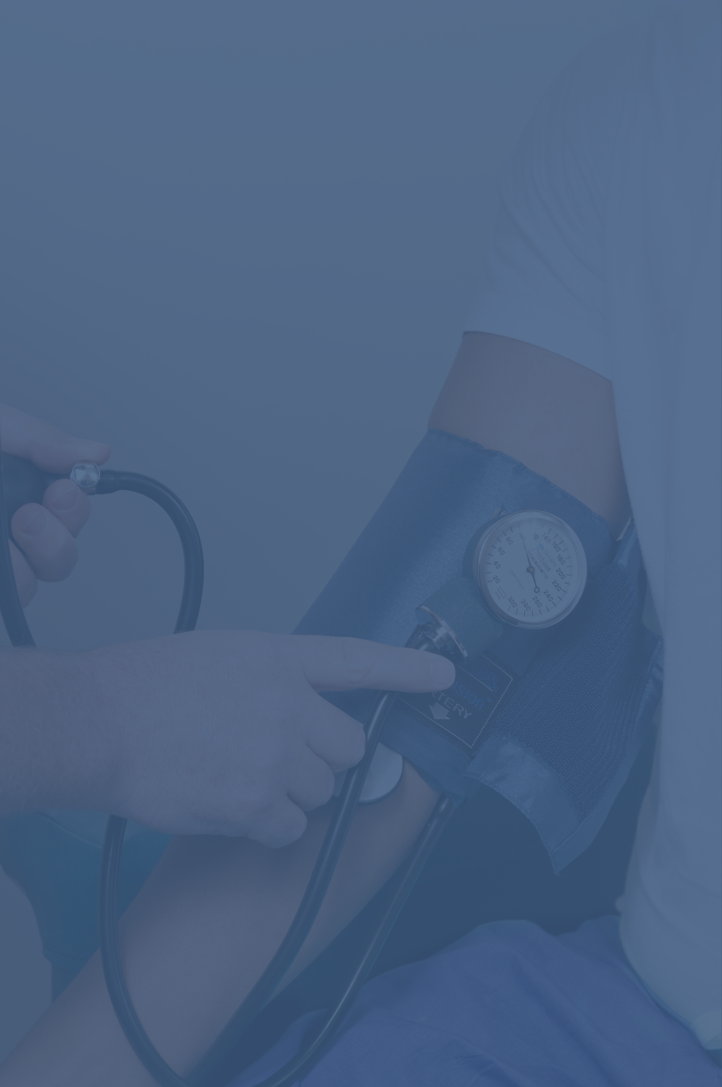


01
INTRODUCTION

Slide 5

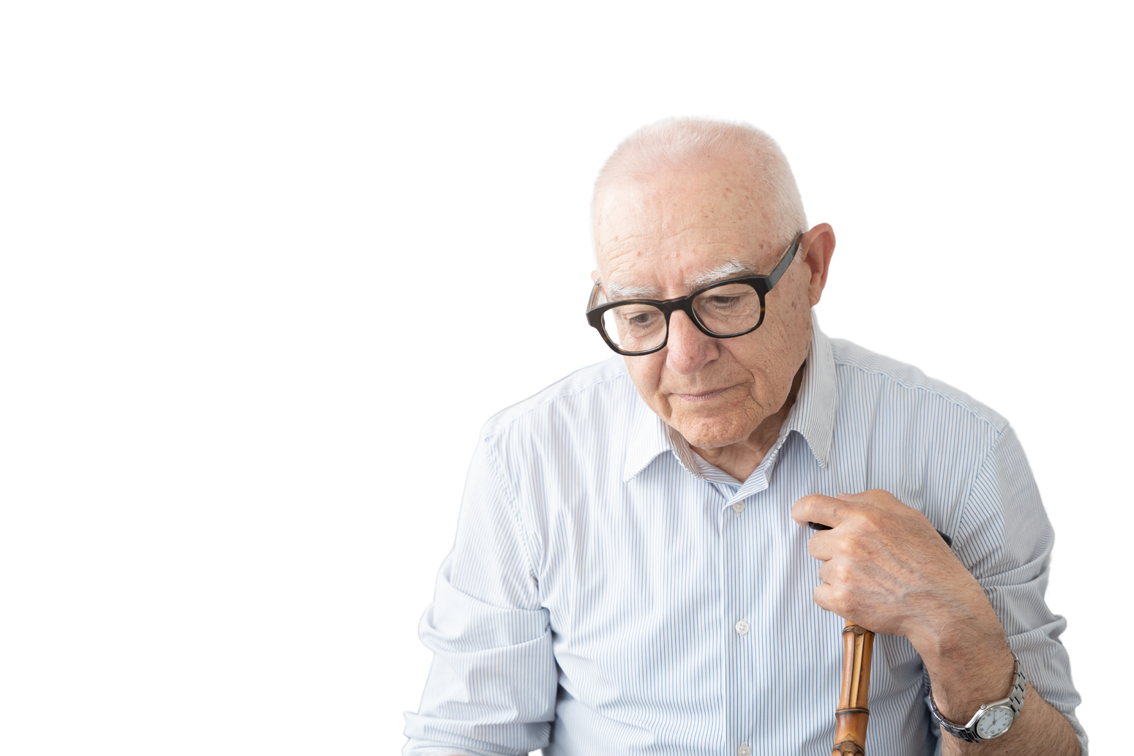

Elder Monitoring: A Vital Need
Rapidly Aging Population
By 2070, the global elderly population (65+) is projected to reach 2.2 billion, up from 1 billion in 2020 [1].
High Risk of Falls
1 in 4 adults aged 65+ falls each year. Falls are the leading cause of fatal and non-fatal injuries among older adults [2].
Chronic Health Conditions Are Common
95% of adults aged 60+ have at least one chronic illness. 80% have two or more chronic conditions [3].
Cognitive Decline and Dementia
Increases risk of wandering, confusion, and unsafe behaviors [4].

Slide 6
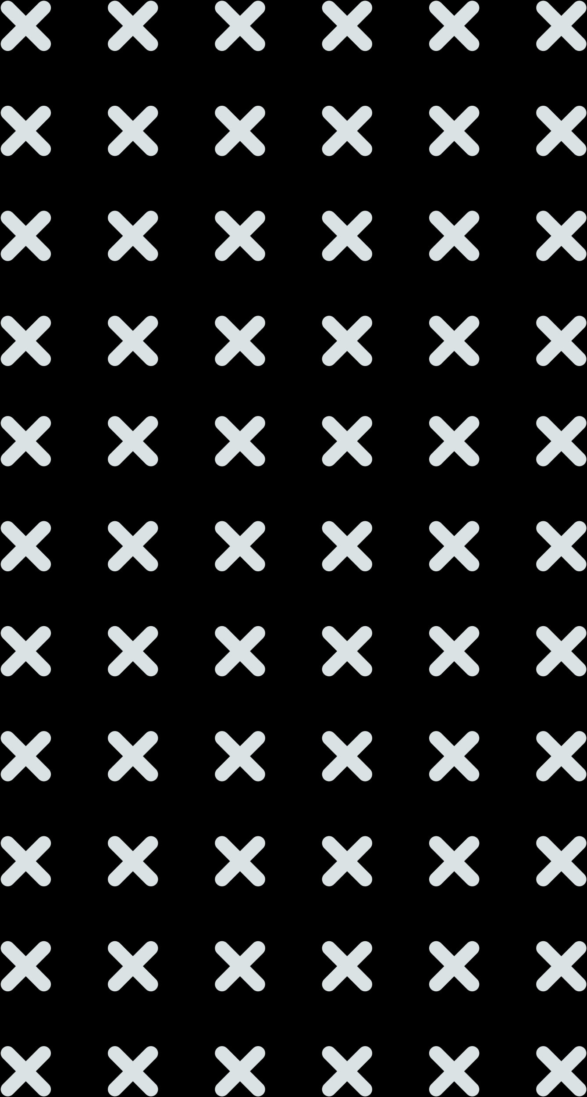

Challenges in Manual Monitoring
High Workload:
Constantly monitoring multiple patients or individuals without automated tools.
Time Consuming:
Regular check-ins, managing schedules, and manually tracking health parameters.
Risk of Missed Emergencies:
Limited ability to respond quickly to health changes or urgent situations.
Wrong Assessments chances:
Human error or oversight in assessing patient health, leading to incorrect interventions.

Slide 7
02
LITRATURE REVIEW

Slide 8
Existing Solutions
McMaster's Smart Home for Aging in Place (Westdale Project)
McMaster's project uses smart technologies to help seniors live independently by monitoring health and environmental factors (e.g., movement, falls, temperature). It allows remote monitoring to reduce reliance on institutional care. [5]
Philips Lifeline:
A medical alert system with wearable devices offering fall detection, GPS tracking, and quick emergency assistance [7].
LifeFone:
A wearable emergency response system that connects elderly users to monitoring centers with a button press for falls or medical emergencies [6].

Slide 9
Existing Solutions – Contd.
AccuHealth:
A remote patient monitoring system for clinics, tracking vitals like blood pressure and pulse in real time, with automated alerts for abnormal readings [8].
Envoyat Home:
A home monitoring system with video, motion detectors, and emergency alerts to notify caregivers of falls or medical issues [9].
IoT-Based Health Monitoring System :
Uses IoT and wearables to track vitals (heart rate, BP) in real time, ensuring continuous monitoring and timely alerts for elderly care [10].
Machine Learning-Assisted Elderly Monitoring System :
Applies machine learning and sensors to monitor activities, detect anomalies (e.g., falls, inactivity), and enable early health risk detection [11].

Slide 10
03
PROBLEM STATEMENT

Slide 11
Problem Statement
Existing health monitoring solutions primarily rely on standard protocols that fail to account for individual behavioral patterns, resulting in limited ability to detect early signs of health deterioration. Furthermore, the dependence on uncomfortable wearable devices reduces user adoption among elderly patients, thereby compromising the overall effectiveness of these systems.

Slide 12



Problem Statement (Cont.)
Generic Monitoring:
Generic Monitoring: Existing solutions use standard protocols that cannot effectively address individual health issues, ignoring personalized behavioral trends.
Lack of Behavioral Monitoring:
Lack of Behavioral Monitoring: Most systems do not analyze patient behaviors for identifying anomalies, trends, or patterns, which are critical for detecting early signs of distress or health decline.
Device Overload:
Device Overload: Many wearable devices are uncomfortable for elderly users, leading to low adoption, thus reducing the overall effectiveness of the monitoring system.

Slide 13
04
PROPOSED DESIGN

Slide 14
Proposed Solution
Non-Intrusive Approach:
The system will use comfortable and minimal wearables, reducing reliance on traditional devices.
Personalized Care:
Tailored Solutions provided for each patient according to their needs.
Real-Time Monitoring & Alerts:
The system will provide continuous monitoring and send instant alerts to caregivers upon detecting critical changes or anomalies.
Behavioral Analysis:
Behavioral trends and anomalies will be identified to detect early signs of distress or health decline.
Dementia-Focused Care
The system will address dementia-specific behaviors like wandering, aggression, and falls for proactive intervention.

Slide 15
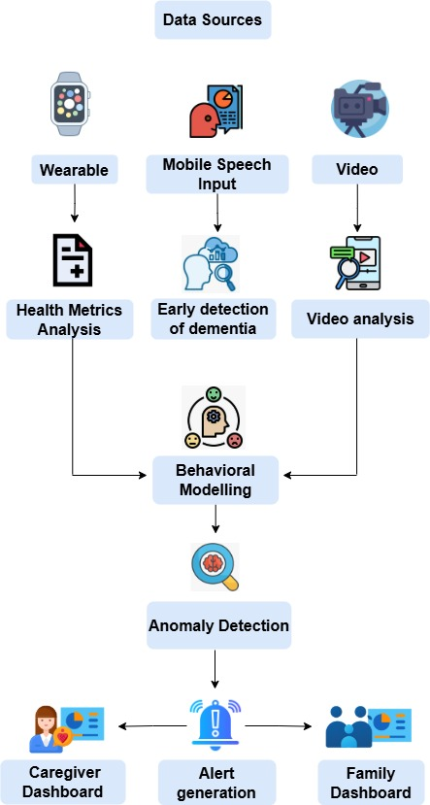



ARCHITECTURE

Slide 16
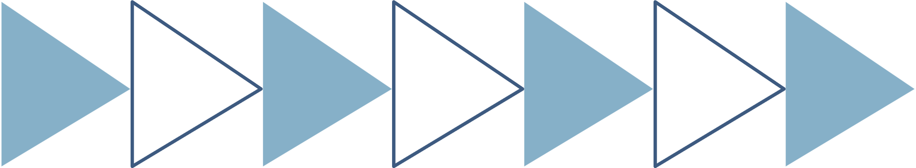
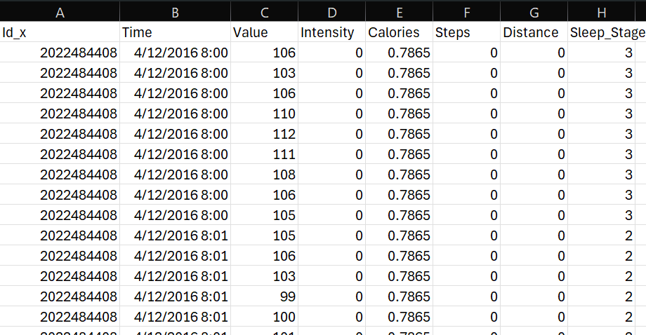

Health metrics
Data Integration and Processing
Combined multiple tables [12] into a single dataset with key metrics.
Heart Rate, Calories, Steps, Distance, Sleep Stage (e.g., Deep, Light, Awake).
Real-Time Simulation:
Applied a time-based loop:
After every 5 seconds, the next row of data is picked and displayed.

Slide 17
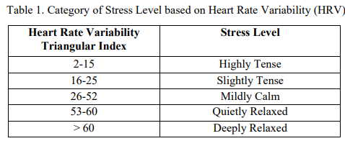
Stress Detection Using HRV
Stress levels are detected using Heart Rate Variability (HRV) triangular index based on the research paper:
“Human Stress Management through Heart Rate Variability”​ [13].
Formula for HRV:
HRVTriangularIndex=(SumofNNintervals)/(MaxNNinterval)

Slide 18
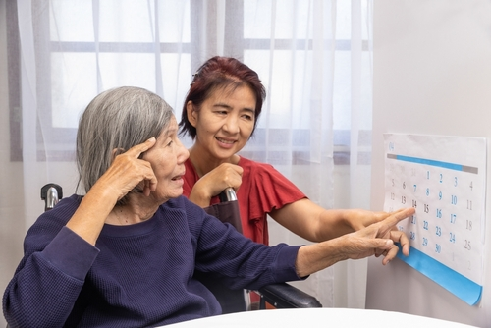
Dementia Detection through Speech
Why?
Dementia affects language, making speech analysis a useful early screening tool.
Traditional tests are time-consuming and Not scalable.
What we have done?
An ML Model to analyze speech recordings and detect signs of dementia.
Model can distinguish between Healthy individuals and Patients with Alzheimer’s.
This aids in early diagnosis, enabling timely treatment and care planning.

Slide 19
Dementia Detection through Speech Contd.
Results and Evaluation:
Model Used: XG Boost
Accuracy: 0.95
Model | Accuracy | Precision | Recall | F1-Score
SVM | 0.50 | 0.25 | 0.50 | 0.33
Random Forest | 0.68 | 0.70 | 0.68 | 0.68
XGBoost | 0.95 | 0.96 | 0.95 | 0.95

Slide 20
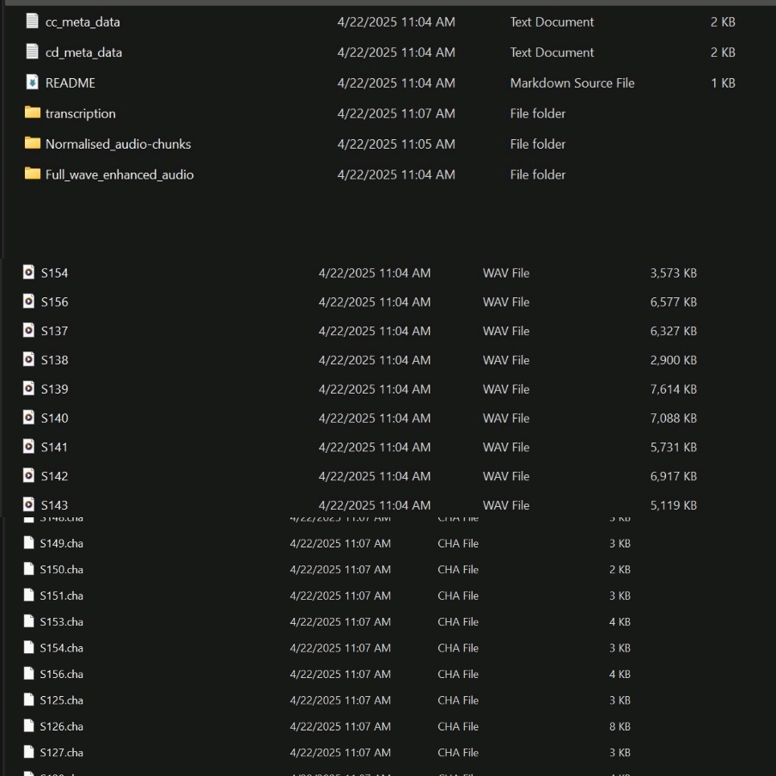
Dementia Detection through Speech Contd.
ADReSS 2020 Dataset from TalkBank [15].
Balanced dataset (age, gender)
Contains audio recordings + text transcripts describing the “Cookie Theft” picture.
Features Extracted:
Linguistic features:
Sentence length, lexical diversity (type-token ratio), part-of-speech usage.
Acoustic features:
MFCCs (Mel Frequency Cepstral Coefficients), Chroma (pitch), Spectral centroid (brightness), Zero-crossing rate (speech fluency)

Slide 21
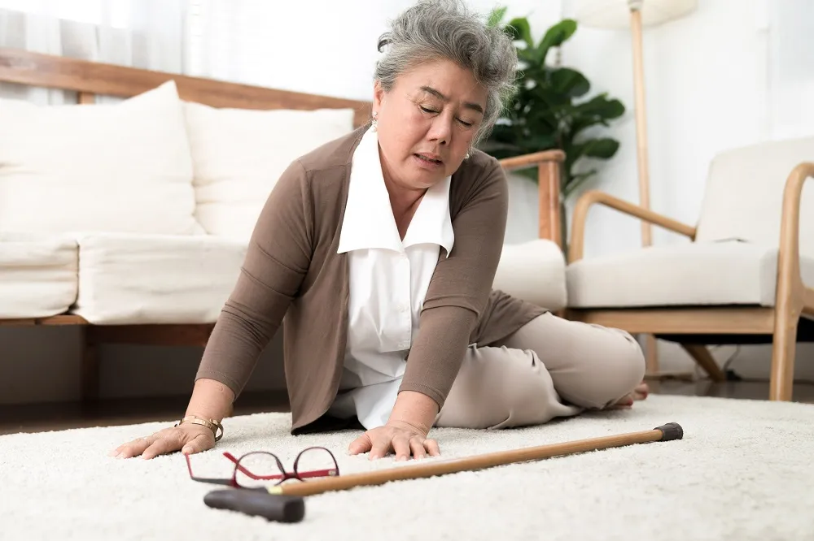
FALL DETECTION MODEL
Why Fall Detection is Critical
1 in 4 elderly adults falls each year. Falls can cause serious injuries or death .
Fast detection can reduce emergency response time
Our contribution
Built a fall detection system using smartwatch sensor data.
Classifies movements into fall vs. normal activity in real time.

Slide 22
FALL DETECTION MODEL RESULTS
Accuracy : 83.53%
MODEL | ACCURACY | PRECISION | RECALL | F1-SCORE
RANDOM FOREST | 83.53% | 0.7749 | 0.5634 | 0.6524
XG BOOST | 82.90% | 0.7379 | 0.5839 | 0.6519
LOGISTIC REGRESSION | 73.84% | 0.8864 | 0.0532 | 0.1004
Dataset
WEDA-FALL: Smartwatch-based dataset (50Hz) with 8 fall types (e.g., forward, backward). Includes timestamps for four phases: Pre-fall, Impact, Adjustment, Post-fall.
Preprocessing
Merged all patient and trial data. Labeled events as:
1 → Fall (based on timestamp phases)
0 → Normal activity

Slide 23
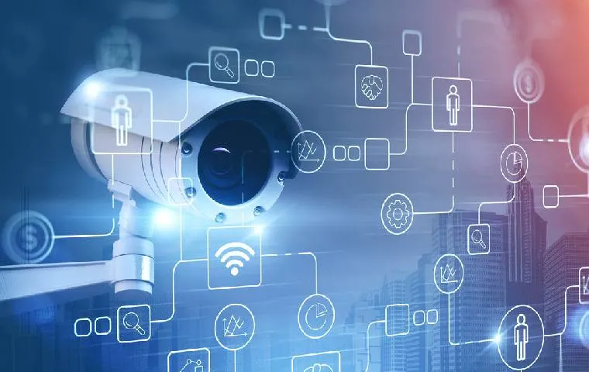
Patient Monitoring through Video
Why Video-Based Patient Monitoring?
In traditional care, caregivers must constantly observe patients to ensure safety, detect emotional distress, or spot unusual behaviour.
This is time-consuming, prone to human error, and not scalable in homes or hospitals.
What We Built
A video monitoring system that:
Recognizes patient faces to track identity
Detects emotions (e.g., happy, sad, confused)
Monitors activities of patients.
Ensures continuous, automated observation.

Slide 24
Patient Monitoring through Video
Data Collection:
Controlled experiment with consenting volunteers.
Participants performed predefined tasks while being video recorded.
Video Processing Steps:
Step | Task | Model | Reason for Selection
1 | Face Detection | MTCNN | High accuracy across poses, robust in occlusions, fast for real-time.
2 | Face Recognition | FaceNet + Linear SVM | Discriminative embeddings, scalability, 100% controlled accuracy.
3 | Emotion Detection | DeepFace | Pre-trained, immediate emotion classification, high accuracy.
4 | Person Detection | YOLOv8n | Lightweight, real-time person tracking even without visible face.
5 | Pose Estimation | MediaPipe Pose | Fast and precise full-body keypoint tracking for activity analysis.

Slide 25
BEHAVIOUR ANALYSIS & ANOMALY DETECTION
Step 1: Data Fusion
Combine wearable data with video data.
Create a unified dataset for each patient.
Step 2: Model Training
Train an Isolation Forest model for each patient to learn their normal behaviour patterns.
Step 3: Real-Time Monitoring
Compare incoming data against learned patterns.
Detect outliers such as unusual inactivity or mood changes.
Outcome
Personalized behaviour profiles for each patient.
Instant alerts to caregivers on detected anomalies.

Slide 26


FRONTEND
Implemented using Figma Design as a reference.
Built with React Native CLI for cross-platform compatibility.
Key Features:
Responsive and user-friendly UI/UX design.
Seamless navigation between modules: Admin, Caregiver, and Family.
Integration of real-time health monitoring dashboards and notifications.
Support for interactive forms for registration, queries, and patient management.

Slide 27
BACKEND SERVERS
Node Server -> Role: Acts as the central hub for application logic.
Functions:
Handles CRUD operations and manages data storage.
Facilitates communication between the mobile application and the FastAPI server.
Technology Stack:
Express.js: Simplifies routing and middleware integration.
PostgreSQL: Allows flexible Schema Design
Advantages:
High performance with non-blocking I/O.
Large ecosystem with extensive library support.

Slide 28
05
MODULES

Slide 29
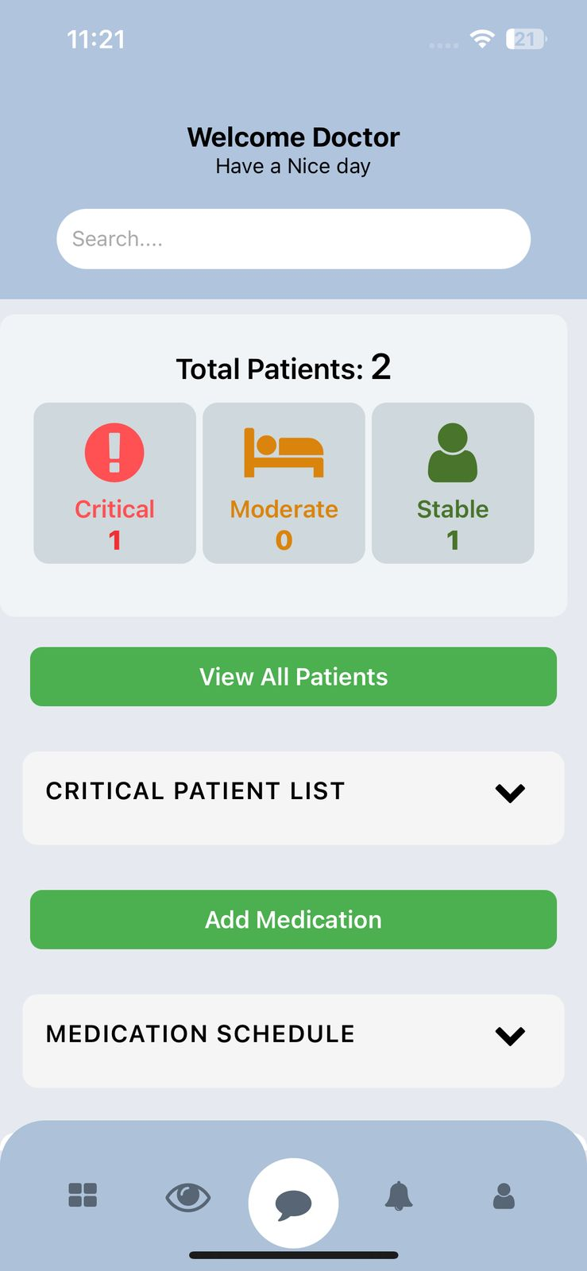
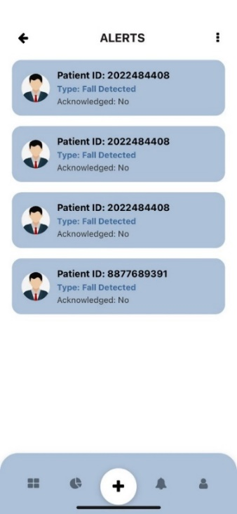
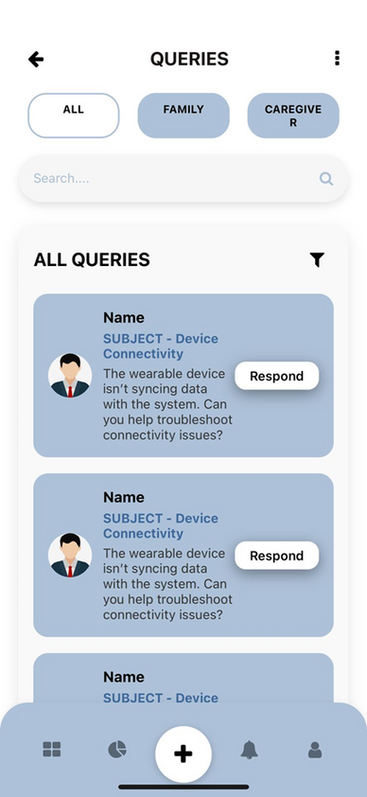
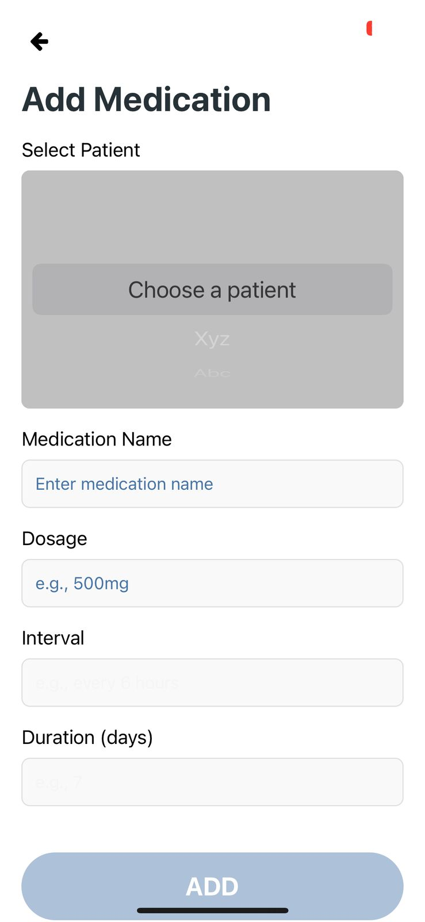
Caregiver Module
Real-time Monitoring
Instant Alerts
Medication Reminders
Patient Notes
Family Queries

Slide 30
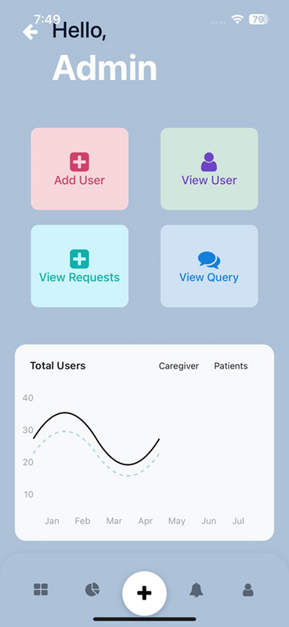
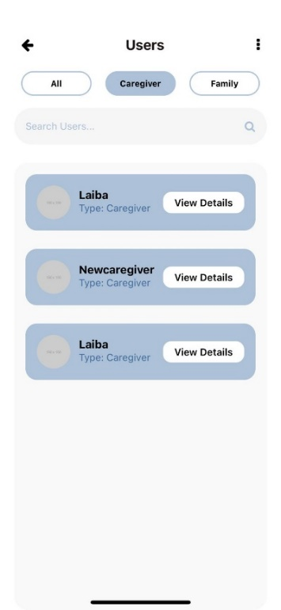
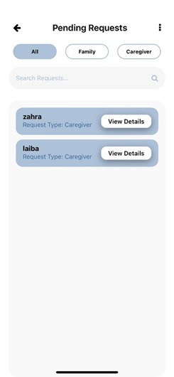
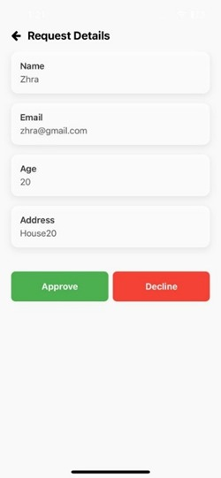
Admin Module
User Management
System Monitoring
Device Management
Insights & Reports

Slide 31
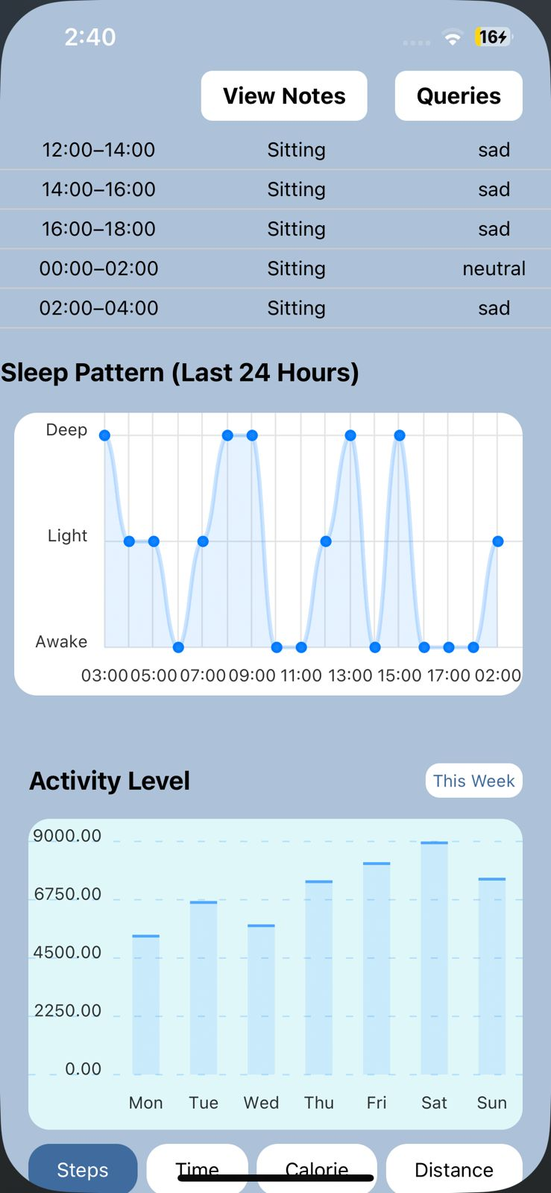
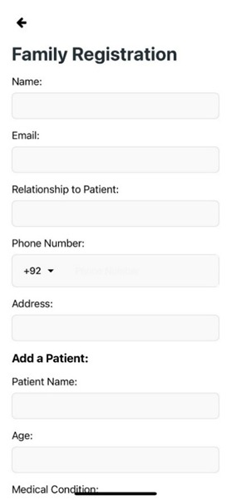
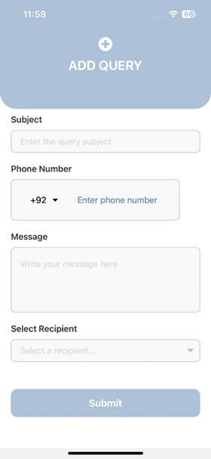
Family Module
Health Insights
Alerts & Notifications
Communication
Health Reports

Slide 32
Individual Contributions
Component | Assigned To
UI/UX Design | Laiba
Frontend Development | Laiba
Backend Development | Khunsha + Laiba
Stress Detection Model | Khunsha
Fall Detection Model | Zahra
Video Analysis Module | Zahra
Personalization & Anomaly detection | Zahra
Speech Detection Module | Khunsha
Reports Feature | Laiba
Integration Testing | Zahra + Laiba + Khunsha

Slide 33
06
CONCLUSION

Slide 34


THANK YOU
We aim to reduce caregiver burden with our automated system for monitoring, behaviour analysis, and timely alerts, ensuring better elderly care.
Smarter care. Safer lives. A new era of elderly support.

Slide 35
References
[1] United Nations Department of Economic and Social Affairs, Population Division. "World Population Prospects 2024: Summary of Results." ReliefWeb, 11 July 2024, https://reliefweb.int/report/world/world-population-prospects-2024-summary-results.
[2] National Institute on Aging. "Falls and Fractures in Older Adults: Causes and Prevention." National Institute on Aging, U.S. Department of Health & Human Services, https://www.nia.nih.gov/health/falls-and-falls-prevention/falls-and-fractures-older-adults-causes-and-prevention?utm_source=chatgpt.com.
[3] National Council on Aging. "The Top 10 Most Common Chronic Conditions in Older Adults." NCOA. https://www.ncoa.org/article/the-top-10-most-common-chronic-conditions-in-older-adults
[4] National Institute on Aging. "Wandering and Alzheimer’s Disease." National Institute on Aging, U.S. Department of Health & Human Services, https://www.nia.nih.gov/health/wandering-and-alzheimers-disease.
[5] https://mira.mcmaster.ca/news-events/in-the-media-mcmaster-university-testing-new-tech-at-westdale-smart-home-to-help-seniors-live-on-their-own/
[6] https://www.lifefone.com/
[7] https://www.lifeline.com/
[8] https://www.accuhealth.tech/

Slide 36
References – Contd.
[9] https://www.envoyathome.com/
[10] Şengül, G., Karakaya, M., Misra, S., Abayomi-Alli, O. O., & Damaševičius, R. (2022). Deep learning based fall detection using smartwatches for healthcare applications. Biomedical Signal Processing and Control, 71(B), 103242. https://doi.org/10.1016/j.bspc.2021.103242
[11] Z. Jiang et al., "Fall Detection Systems for Internet of Medical Things Based on Wearable Sensors: A Review," in IEEE Internet of Things Journal, vol. 11, no. 21, pp. 34797-34810, 1 Nov.1, 2024, doi: 10.1109/JIOT.2024.3421336.
[12] https://www.kaggle.com/datasets/gabrielgvb/fitabase-data-4-12-16-5-12-16/data
[13] Bukhari Shafiq Bin Asnain, Siew-Chin Chong, and Kuok-Kwee Wee, (2018), Human Stress Management through Heart Rate Variability, I.J. Image, Graphics and Signal Processing, 8, 9-17 (paper on web)
https://www.mecs-press.org/ijigsp/ijigsp-v10-n8/IJIGSP-V10-N8-2.pdf
[14] https://github.com/joaojtmarques/WEDA-FALL
[15] https://media.talkbank.org/dementia/English/0extra/ADReSS-2020

Slide 37

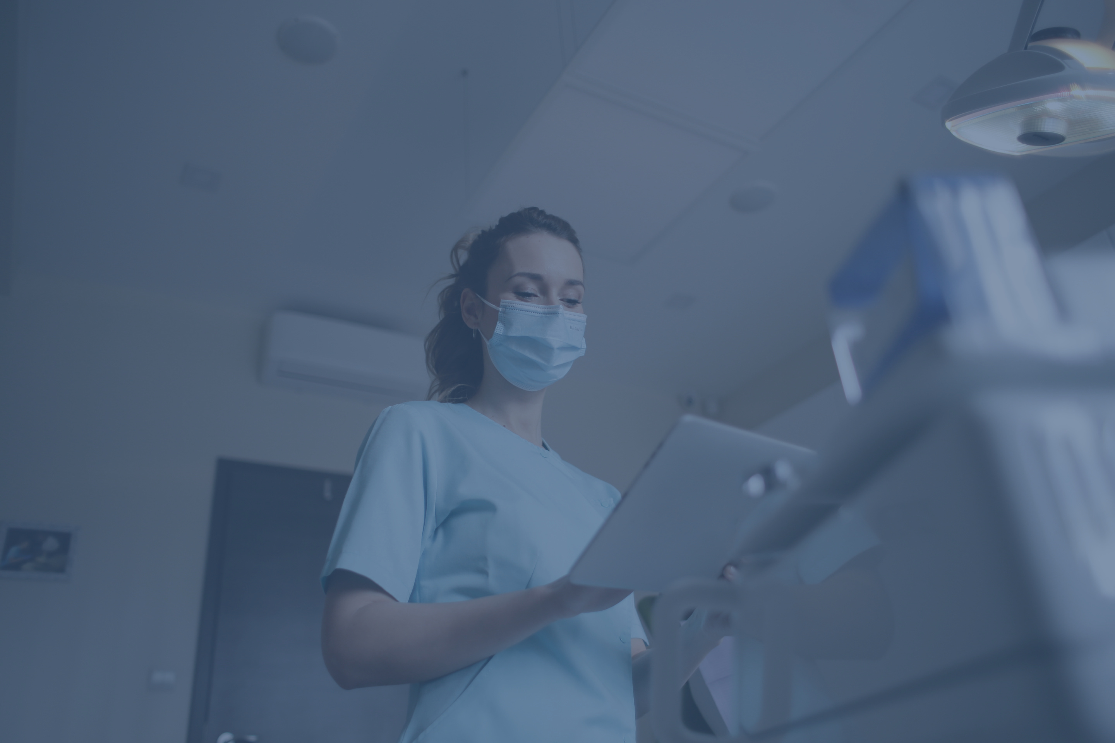
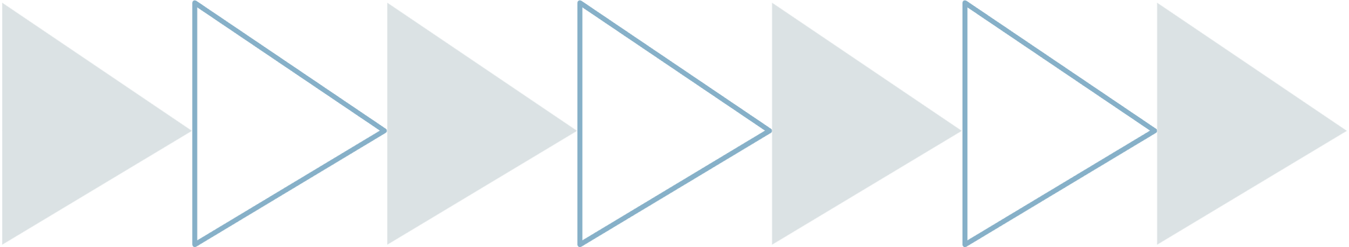

Thanks!
Do you have any questions?

